Slide 1
Creating software to improve reading of English as a Second Language students

Slide 2

Is reading comprehension a problem?
Research has shown that many ESL readers are word-by-word readers
The issue is not only at ODU but at English Language Centers around the Country
In some cultures, L1 reading literacy is low

Slide 3
In addition
Research has found that efficient readers
Reduce the number of fixations
Reduce the number of regression
Especially difficult with different orthographies

Slide 4
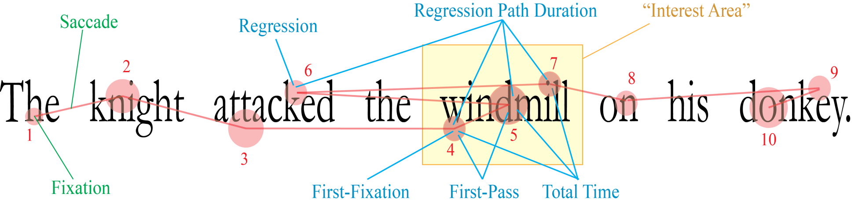
Fixations and Regressions

Slide 5
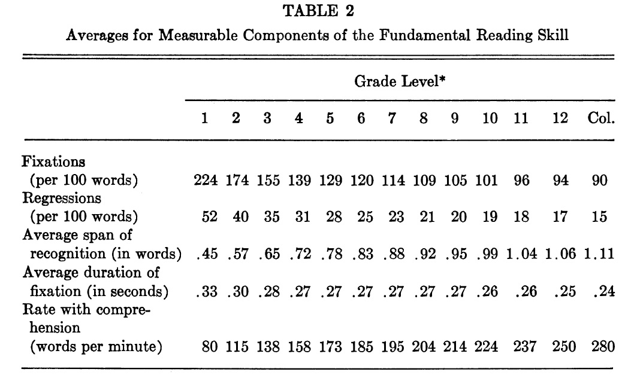
Fixations and Regressions
* Eye Movements in Reading: Facts and Fallacies, Author(s): Stanford E.
Taylor American Educational Research Journal, Vol. 2, No. 4

Slide 6
So what do we see in our programs?
 | Low Beginning ESL Literacy | Beginning ESL | Low Intermediate ESL | High Intermediate ESL | Low Advanced ESL | Advanced ESL
Words per minute | <180 | 191-200 | 201-210 | 211-200 | 221-235 | >235
CASAS
Ranking of 15 beginning Advanced I Readers
69-138 WPM | 182 WPM | 202.2 WPM
13 | 1 (low beginning) | 1 (low intermediate)

Slide 7
Idea
Research has found that efficient readers
Increase recognition of “lexical bundles”
Increase awareness of thought groups

Slide 8
First part of analysis – identifying bundles
once a week
In the last two years
Over time
In the last few years
A decade ago
In the 1980s
waiting for the day
in the habit
In one (a) recent survey
There was nothing like this
numbers speak for themselves
In some ways

Slide 9
Lexical bundles
Teaching them to recognize common lexical bundles
as a result of
at the same time
on the other hand
is based on the
is one of the
is due to the

Slide 10
Reading Speed
Survey Question | Strongly Agree | Agree | Do Not Agree or Disagree | Disagree | Strongly Disagree
I feel good about the way the reading techniques were implemented in the classroom. | 7 | 4 | 1 | 0 | 0
I believe that using the software to present the readings helped improve my reading speed. | 8 | 2 | 2 | 0 | 0
I believe that identifying word clusters often used in English have helped improve my reading speed and comprehension. | 9 (one written comment: “great”) | 3 | 0 | 0 | 0
I noticed an improvement in my reading comprehension. | 6 | 6 | 0 | 0 | 0
I noticed an improvement in my reading speed. | 5 | 4 | 3 | 0 | 0
I thought the process was valuable. | 6 | 6 | 0 | 0 | 0

Slide 11
Spreeder
http://www.spreeder.com

Slide 12
Slash Reading
Break a sentence before each conjunction or preposition, as well as if and whether, after a comma, after words such as “said, thought, wondered, I’m sure, I’m glad, I’m sorry, I’m disappointed” *list follows)
Circle each pronoun (he, him, she) and draw an arrow to its referent.
Circle the main subject and underline main verb of each sentence.
Circle all instances of who, what, when, why, how and that

Slide 13

Not only ELC

Slide 14
Wish list (extensions)
It would be good for the teacher to be able to modify groups or clusters by using visible breaks in the saved document.
In particular, it would be good to bold or underline the verbs or bold and underline the subjects. Colors could be used instead.
Possibly, modifying clauses and phrases could be signified in some manner. Maybe colors.
Something students could use – and that we might even be able to track for homework.

